Slide 1
Unsupervised Learning

Slide 2
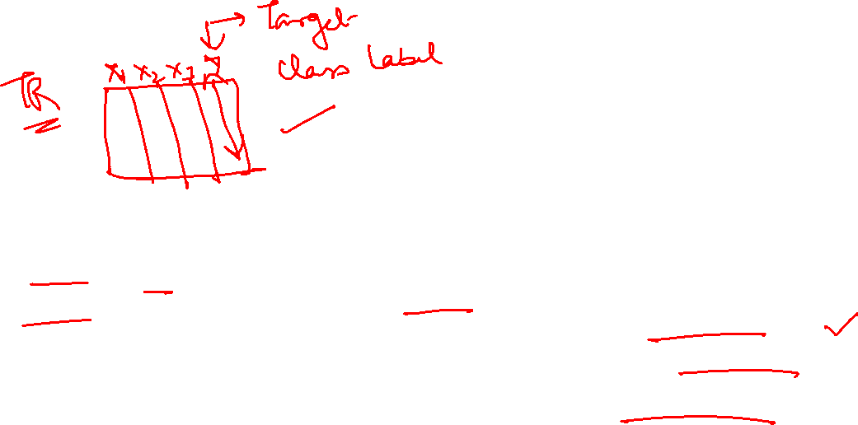
Introduction to Unsupervised Learning
A type of machine learning that deals with unlabeled data
The system tries to learn patterns and structure without predefined labels
Main goals:
Discover hidden patterns
Find structure in data
Reduce data complexity

Slide 3
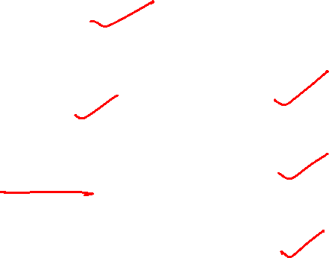
Key Characteristics
No target variable
Learning from the structure of the data
Mainly used for:
Clustering
Association rule learning
Dimensionality reduction

Slide 4
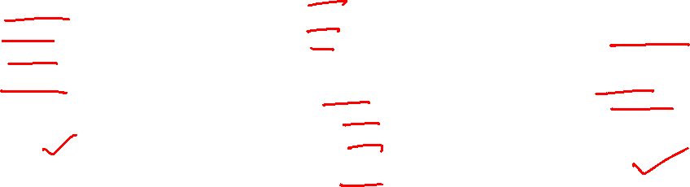
What is Clustering?
A way of grouping together data samples that are similar in some way - according to some criteria that you pick.
A form of unsupervised learning – you generally don’t have examples demonstrating how the data should be grouped together
So, it’s a method of data exploration – a way of looking for patterns or structure in the data that are of interest

Slide 5
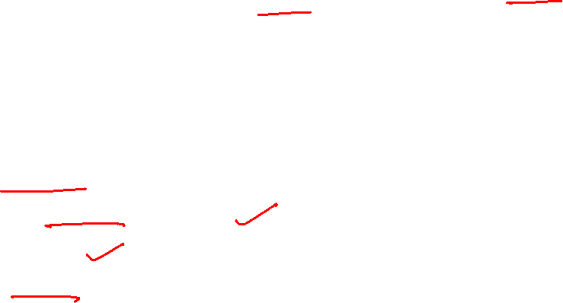
Difference between Clustering and Classification
Uses Unsupervised machine learning
Clustering uses Unlabeled Data as an Input
The Output is unknown
There is no target variable in clustering

Slide 6
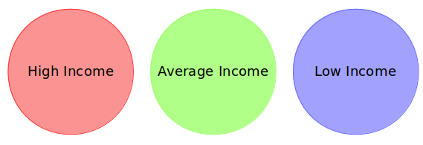
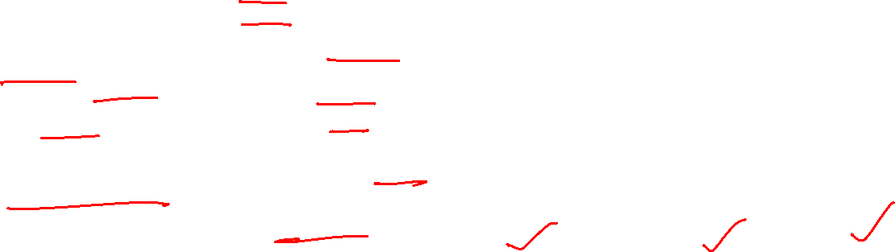
Example
A bank wants to give credit card offers to its customers. Currently, they look at the details of each customer and, based on this information, decide which offer should be given to which customer.
Now, the bank can potentially have millions of customers. Does it make sense to look at the details of each customer separately and then make a decision? It is a manual process and will take a huge amount of time.
So what can the bank do? One option is to segment its customers into different groups. For instance, the bank can group the customers based on their income:

Slide 7
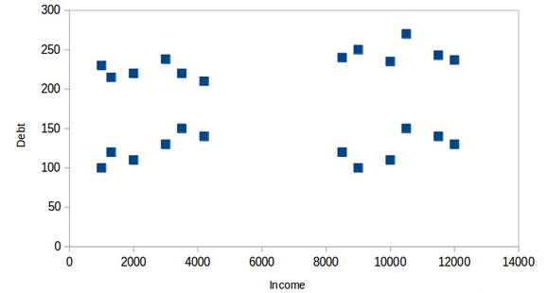
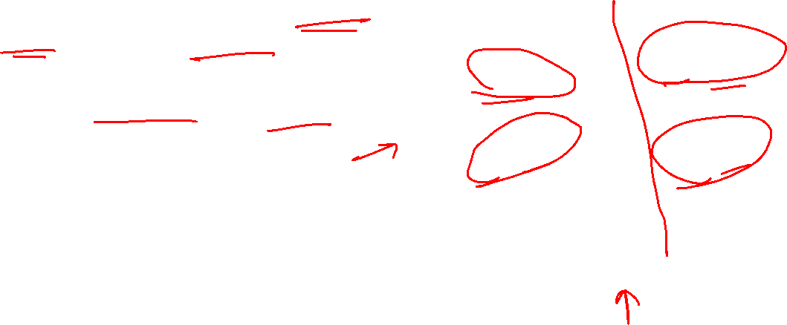
How unsupervised algorithm helps
For simplicity purposes, let’s say the bank only wants to use the income and debt to make the segmentation.
They collected the customer data and used a scatter plot to visualize it:

Slide 8
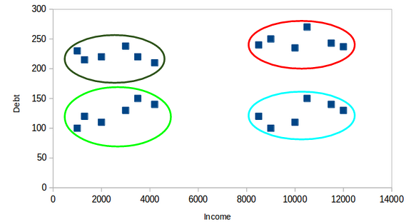
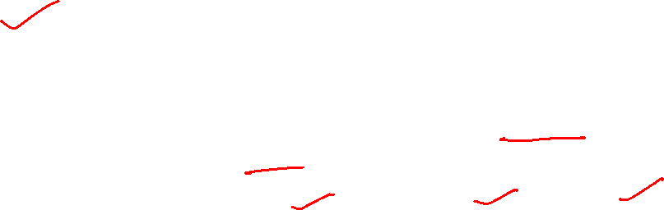
How unsupervised algorithm helps
On the X-axis, we have the income of the customer, and the y-axis represents the amount of debt. Here, we can clearly visualize that these customers can be segmented into 4 different clusters, as shown here
This is how clustering helps to create segments (clusters) from the data. The bank can further use these clusters to make strategies and offer discounts to its customers

Slide 9
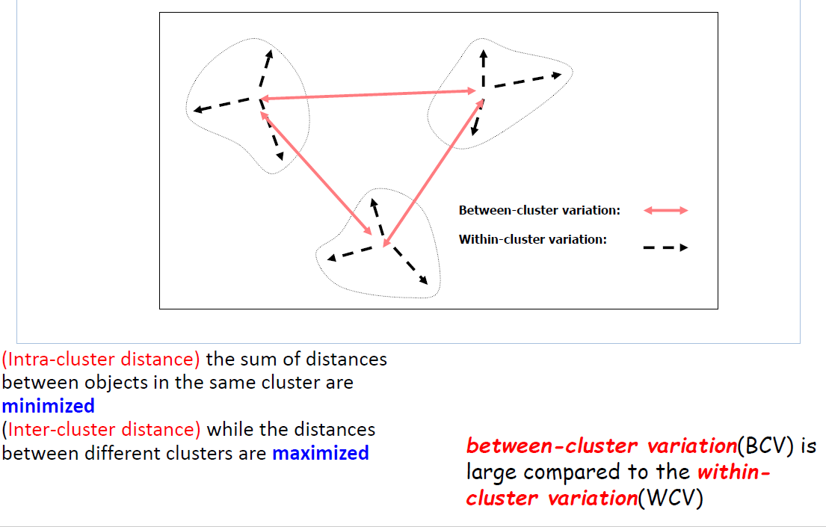
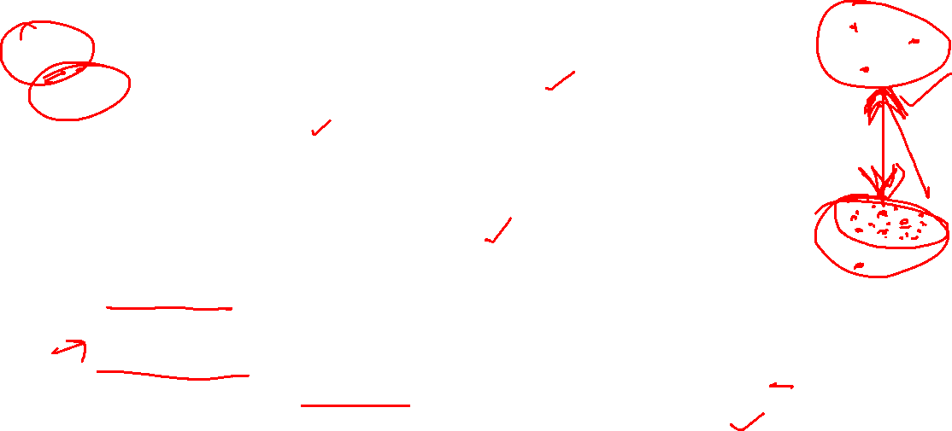
Goal of Clustering

Slide 10
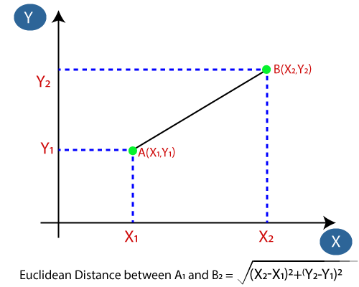
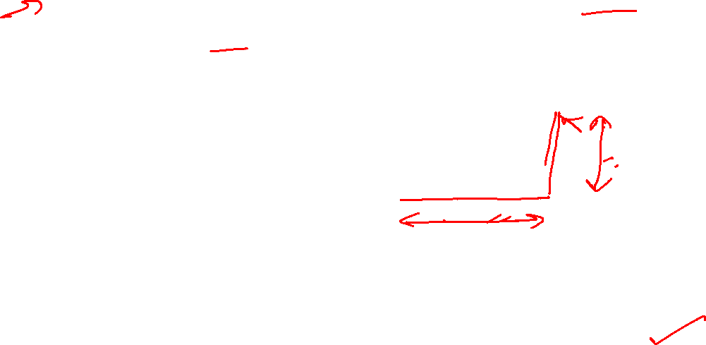
Different distance measure
Euclidean Distance: The Euclidean distance is the distance between two points, which we have already studied in geometry. It can be calculated as:

Slide 11


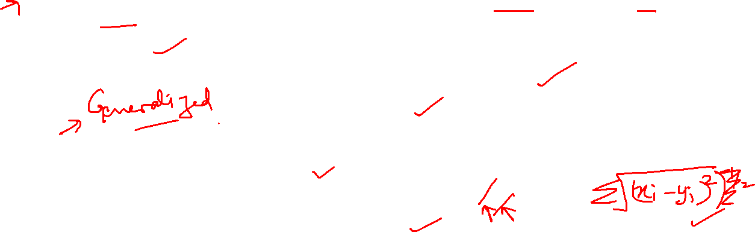
Different distance measure
Manhattan Distance: It is used when we are interested in the total distance traveled by the object instead of the displacement. This metric is calculated by summing the absolute difference between the coordinates of the points in n-dimensions.
Minkowski Distance: We can say that the Euclidean, as well as the Manhattan distance, are special cases of the Minkowski distance.
From the formula above we can say that when p = 2 then it is the same as the formula for the Euclidean distance and when p = 1 then we obtain the formula for the Manhattan distance.

Slide 12
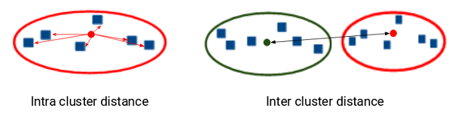

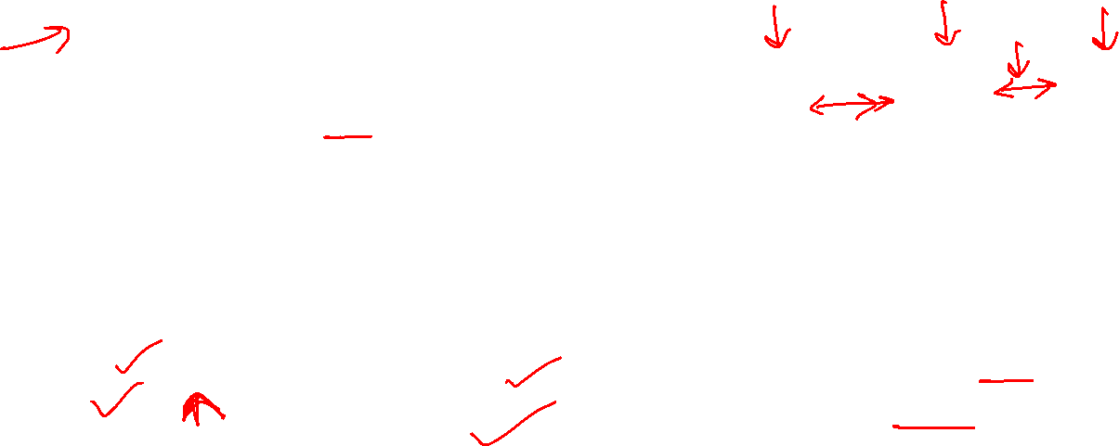
Different Evaluation Metrics for Clustering
Dunn Index:.
The ratio of the minimum of inter-cluster distances and maximum of intracluster distances.
Inertia tries to minimize the intracluster distance. It is trying to make more compact clusters.
The MORE the value of the Dunn index, the better the clusters will be

Slide 13
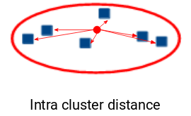
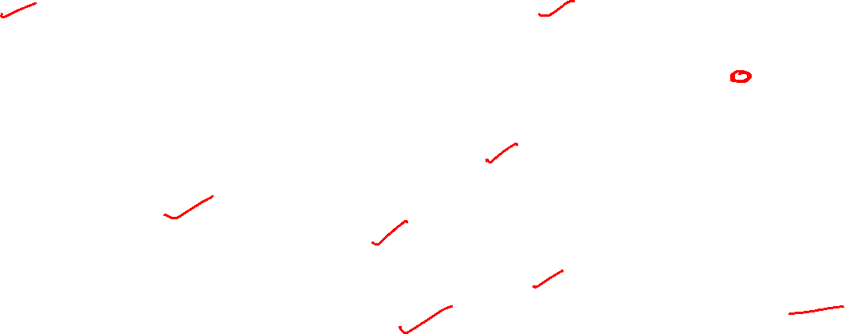
Different Evaluation Metrics for Clustering
Inertia : It tells us how far the points within a cluster are.
Inertia actually calculates the sum of distances of all the points within a cluster from the centroid of that cluster.
Normally, we use Euclidean distance as the distance metric, as long as most of the features are numeric
Manhattan distance in case most of the features are categorical.
We calculate this for all the clusters
The final inertia value is the sum of all these distances. This distance within the clusters is known as intracluster distance.
That the LESSER the inertia value, the BETTER our clusters are.

Slide 14
Thank You

